Slide 1


Reorganising Canolfan Enfys to place the provision under the management of Ysgol Pen Coch and increase the nominal capacity from 98 to 128 from 1st March 2025.
Quick read
YOUNG PEOPLE DOCUMENT

Slide 2
Introduction
The Council is seeking your views on a proposal to reorganise the provision at Canolfan Enfys and move the provision from under the current management of Plas Derwen (Pupil Referral Unit) to under the management of Ysgol Pen Coch. The proposal will result in the nominal capacity at Ysgol Pen Coch increasing from 98 to 128 by March 2025.
Want more information?
If you would like to learn more about our plans we have prepared a more detailed document. Follow this link www.flintshire.gov.uk/schoolmodernisation
Consultation
Planning
Consideration

Slide 3




What are we doing?
The Council must follow certain processes when considering making significant changes to schools.
As part of these processes, we have started a formal discussion to ask for your views to help our decision-making process.
Your views are very important to us and will be given to the Council’s Cabinet to make a decision to make changes to Canolfan Enfys and Ysgol Pen Coch.
Councillors will discuss your views, issues and the implications for Canolfan Enfys and Ysgol Pen Coch and then will decide what happens next.
Consultation
Planning
Consideration

Slide 4
Canolfan Enfys - Background
Canolfan Enfys is a foundation stage provision and assessment centre and is based on a shared campus with Ysgol Bryn Gwalia C.P in Mold. Since 2015, Canolfan Enfys has been structured as part of the portfolio of Plas Derwen (Pupil Referral Unit), putting it under the management of the Headteacher. Canolfan Enfys has a dual function to provide a foundation stage provision for children with complex needs whilst assessing and determining future provision for the children that attend.
Consultation
Planning
Consideration

Slide 5
Why are we thinking about changing things?
The Estyn inspection of Plas Derwen in October 2023 determined that Canolfan Enfys needed improvement and that the expertise to support the service did not sit within Plas Derwen given the very different nature of the provision offered and the complex needs of the children attending Canolfan Enfys. The authority was advised to remove it from the management of Plas Derwen and secure suitable management through an alternative mechanism.
Consultation
Planning
Consideration

Slide 6
What are we proposing?
The Council is seeking to reorganise the provision at Canolfan Enfys and move the provision from under the current management of Plas Derwen (Pupil Referral Unit) to under the management of Ysgol Pen Coch. The proposal will result in the nominal capacity at Ysgol Pen Coch increasing from 98 to 128 by March 2025.
The increase in nominal capacity would be achieved through Ysgol Pen Coch taking control of the management of Canolfan Enfys at its current base on the same site as Ysgol Bryn Gwalia in Mold.
Consultation
Planning
Consideration

Slide 7
What are the advantages and disadvantages of the proposal?
Advantages
Most children at Canolfan Enfys already transition to Ysgol Pen Coch. Centre can formally draw upon the expertise at Ysgol Pen Coch. Transition would be relatively smooth due to informal working arrangements already taking place.
Disadvantages
Distance of the provision from the main site at Ysgol Pen Coch.
Consultation
Planning
Consideration

Slide 8
Timescales
Stage of Process | Key Dates
Formal Consultation | 5th June 2024 to 16th July 2024
Cabinet consider the results of the consultation and determines whether to proceed with proposals | September 2024
Council publish statutory notice and enter into objection period | October 2024
Cabinet consider the objection report and determine whether or not to implement the proposals | December 2024
Decision notification letter is issued with outcome from Cabinet determination | January 2025
Consultation
Planning
Consideration
* these dates may be subject to alteration dependent on cabinet approvals.

Slide 9

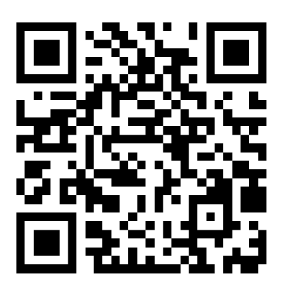
Tell us what you think
We really want to know what you think of the provision in your area and also your views on the options available for the schools in the area.
You can let us know through a number of ways. 
If you would like a paper copy of this document or further information please contact us at
21stcenturyschools@flintshire.gov.uk
or call
01352 704018 or 01352 702188
 Online
Using the link to survey
https://www.smartsurvey.co.uk/s/canolfanpencoch/
QR Code
You can respond to the survey online by
scanning the QR code
 Paper
You can respond in writing by sending questionnaires and written responses to:
School Modernisation Team, Ty Dewi Sant, St David’s Park, Ewloe, Flintshire, CH5 3TX
Further information can be found at
Thank You!
You can tell us what you think from the 5th June 2024. You must respond by 16th July 2024

