Slide 2


Background
Our Customer Service Strategy sets out how the Council will deliver modern and efficient face to face, telephone and digital services.
Our vision is to embrace opportunities to review, assess and implement changes to the way customers can contact Flintshire County Council.
Easily accessible
Simple to use
Streamlined
Convenient
Cost effective
Reliable

Slide 3
Digital Services
Our commitment:
Empower customers to access the services and information they need online
Provide services and information online in a user-friendly way
Maximise self service to release resources to help our most vulnerable customers
Support customers where they lack digital skills and/or confidence

Slide 4
My Account
Connect with the Council 24 hours a day 7 days a week using a computer, mobile phone or tablet
Create a My Account using your email address and password (Welsh and English options)
Access waste, recycling and planning information, view who your local councillor is and much more
Tenants can link their tenancy details to My Account
Track the progress of repairs and online requests made to the Council, view rent statements and pay for services
Customise your account to display information that meets your individual preference and interests
Your information is safe and secure

Slide 5


Slide 6
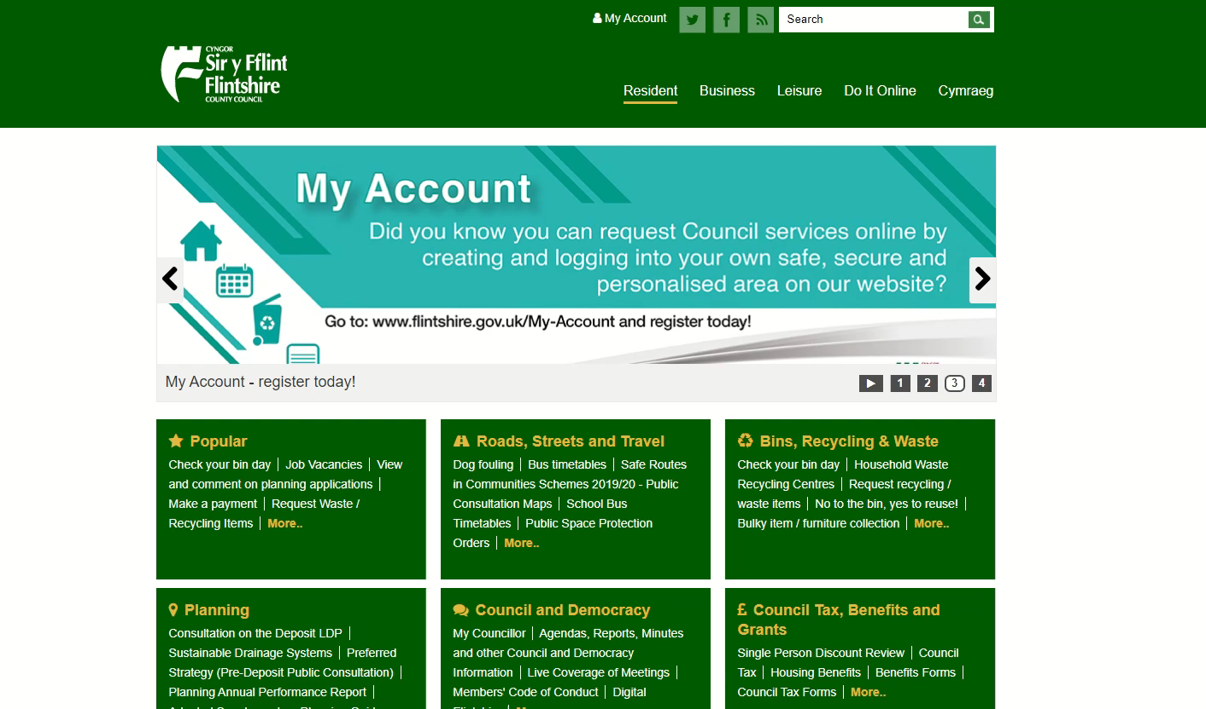
How to create a My Account

Slide 7
Questions?

