Slide 1
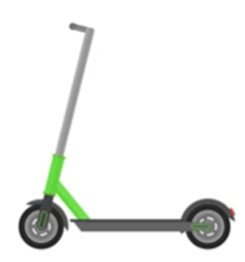
How many different types of transport can you think of?

Slide 2
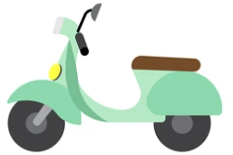
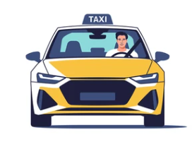
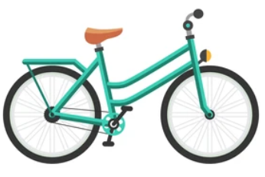
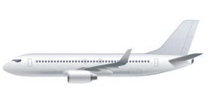
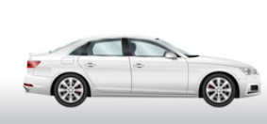
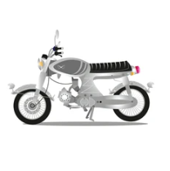
Notes:
Cars - Bikes - Planes - Motorbike
Trains - Scooters - Boats
Buses - Taxis - Walk

Slide 3
Jargon Buster
Fossil Fuels
A natural fuel such as coal, gas and natural oil. It is used to power engines/provide heat/electricity.
This energy source is not renewable which means once it's used up, its gone.
Atmosphere
A layer of gas that surrounds the earth, which has many different gases including oxygen.
Greenhouse gases
Gases in the Earth’s atmosphere that trap heat.
Sustainable
Using resources in a way which allows them to be available in the future.

Slide 4
What are the effects of cars on the environment?
Oil and Gas are fossil fuels which are used to power cars/trains/buses/motorcycles
When fossil fuels are burnt, they release greenhouse house gases
These greenhouse gases trap heat in our atmosphere.
This warms our planet which causes more extreme weather.

Slide 5
What types of transport are better for the planet?
Notes:
Trains - Bike
Buses - Scooter
Walk - Electric cars

Slide 6
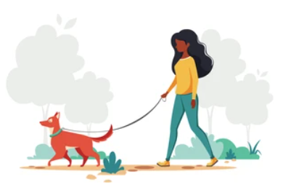
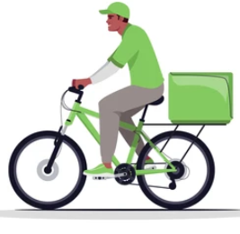
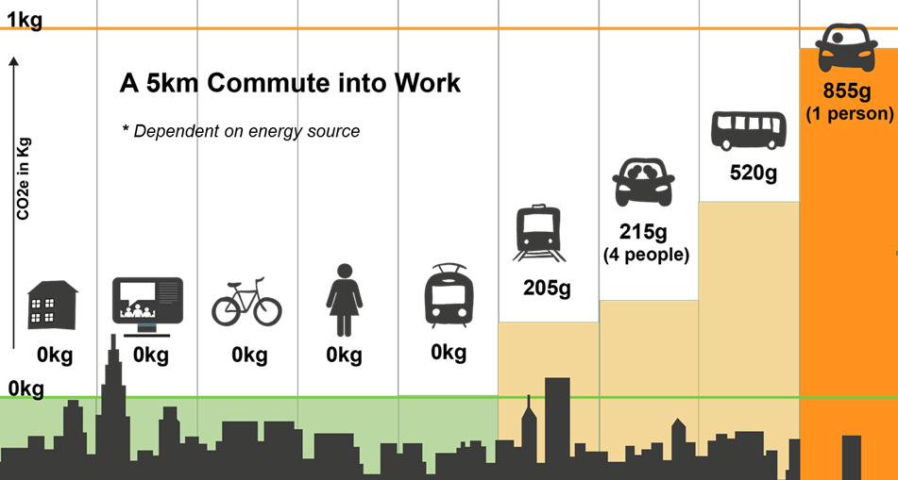
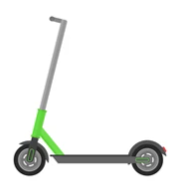
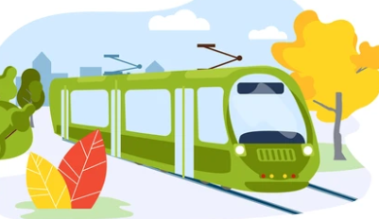
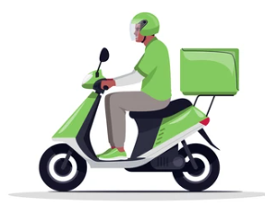
Notes:
Trains - Bike
Buses - Scooter
Walk - Electric cars

Slide 7
What transport do you use to get to school ?

Slide 8
Benefits of sustainable transport.
Reduces your carbon impact
Walking and cycling increases fitness and health
Better air quality – as less cars on the road
Safer roads – as there is less cars on the road
Sustainable transport reduces greenhouse gas emissions – Reduces the warming of the planet

Slide 9
What can help us to use more sustainable transport?

Slide 10
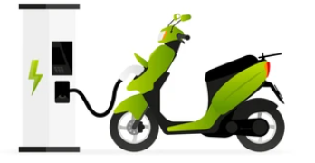
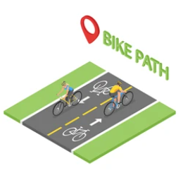
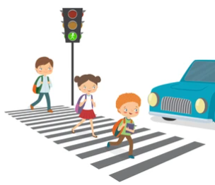
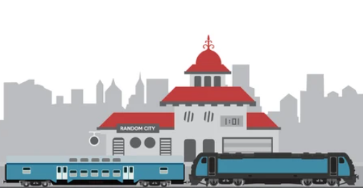
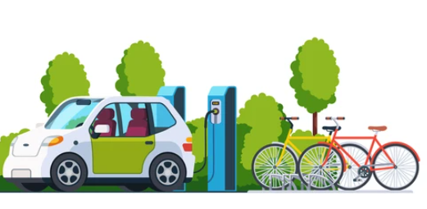
More walking and cycle routes
More bus routes
Storage for bikes & scooters
Cycle lanes
Electric charging points
More train stations in rural areas
Cycle to school schemes

Slide 11
ACTIONS !
Try a sustainable transport option to school:
Walk
Cycle
Scooter
Encourage the school council to take up:
Walking School Bus
Bike School Bus.
Create a campaign to:
Increase the amount of cycle lanes near your school
Reduce the amount of traffic that surrounds the school

