Slide 1

Recycling Lesson

Slide 2


What does ‘recycle’ mean?
Recycling
To recycle an item means to use the item to make something new.
Have you seen this symbol before?
If you see this symbol on packaging, it means that there
will be information on recycling the item

Slide 3


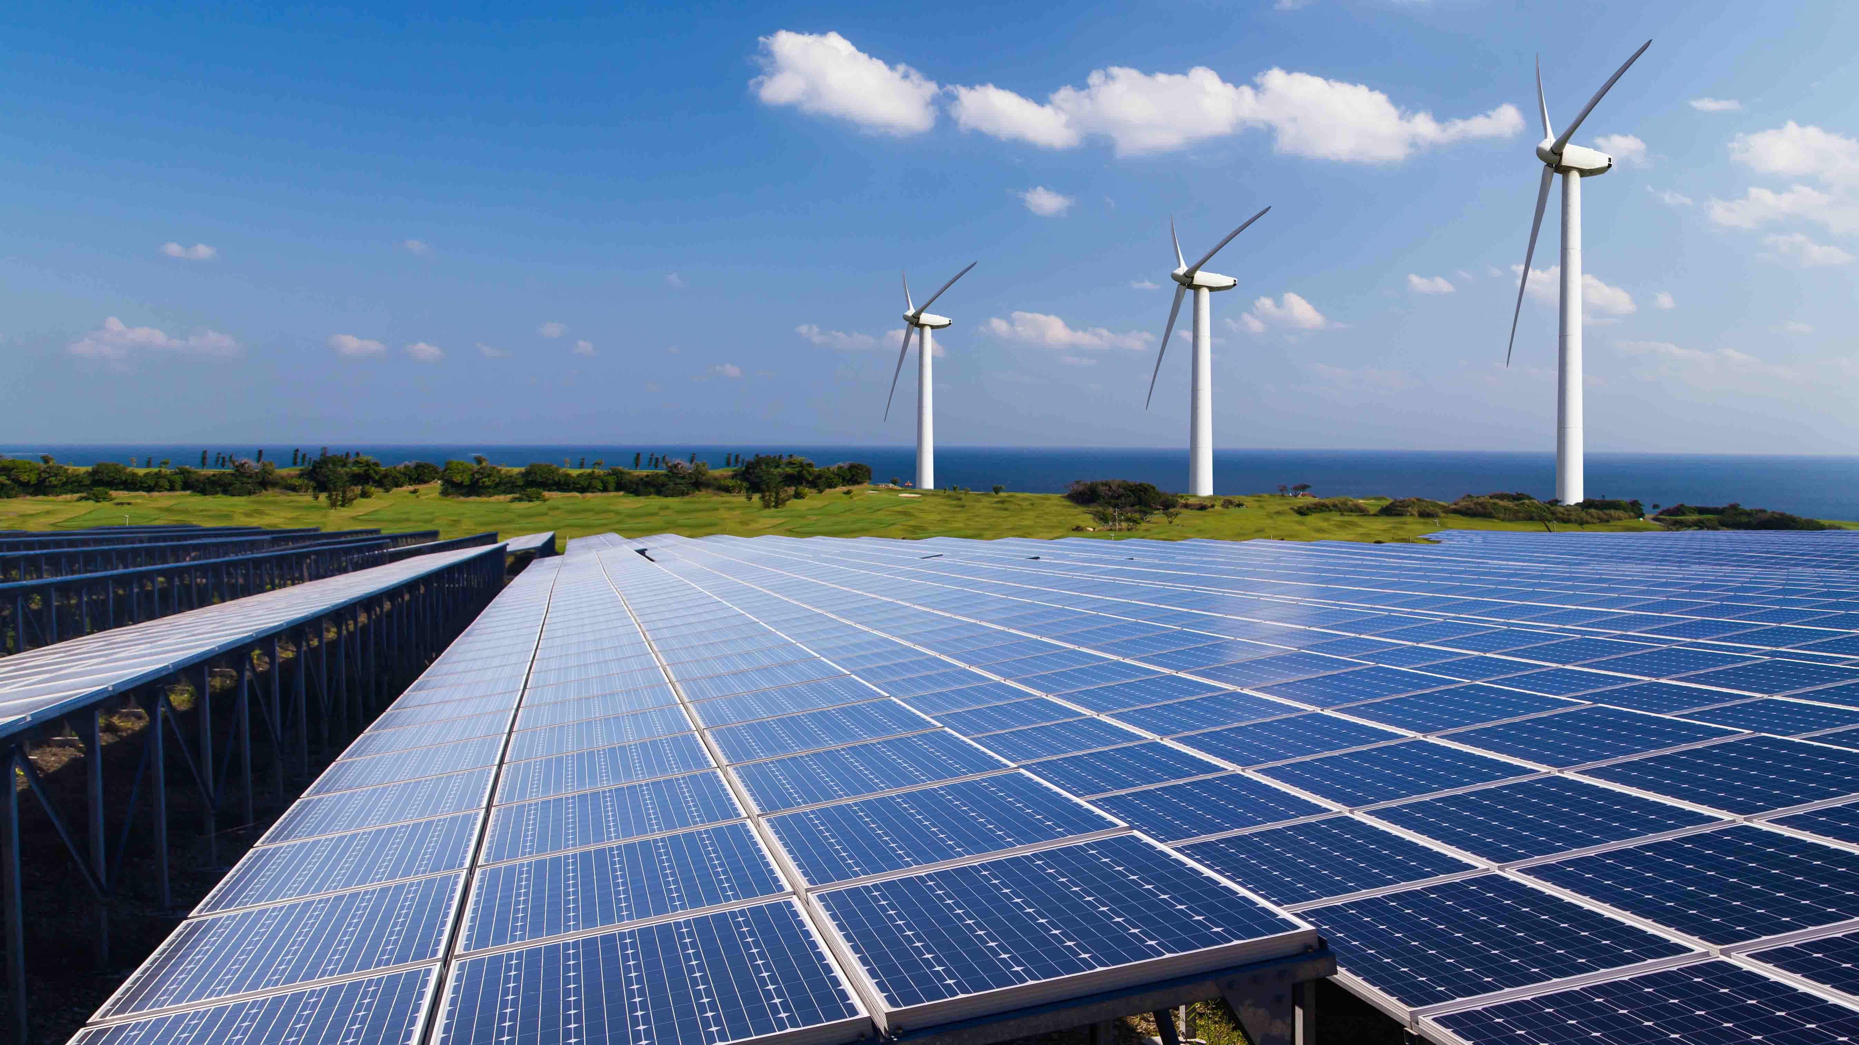
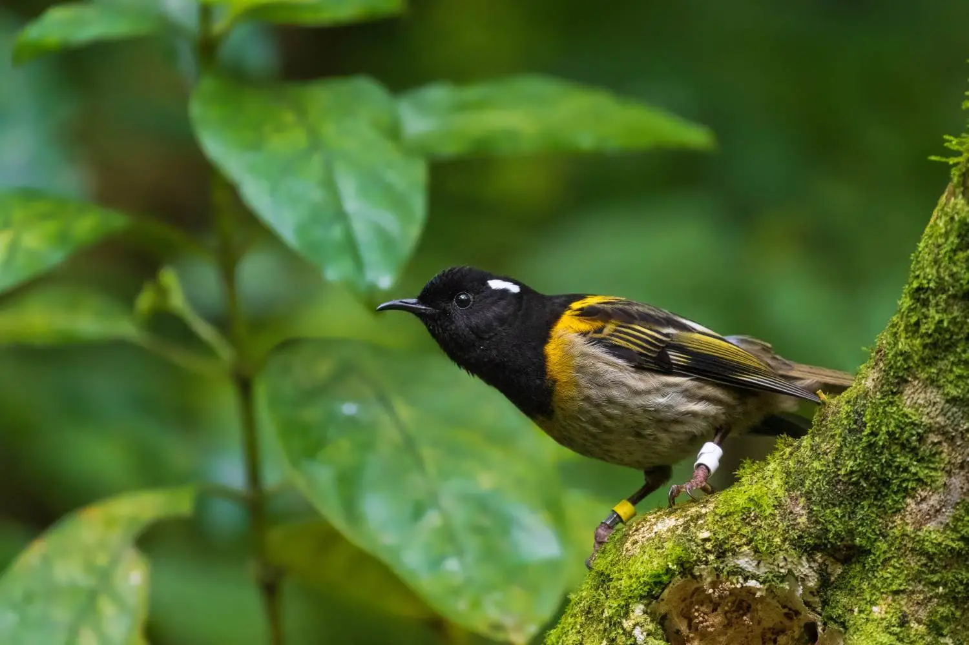
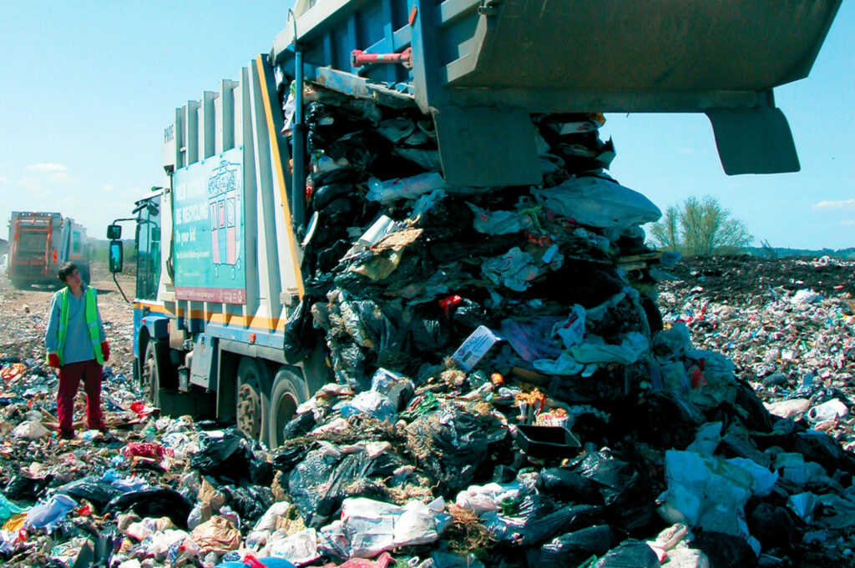
Why should we recycle?
Saves resources
Saves energy
Reduces landfill or burning
Protects the environment

Slide 4





What can I recycle?
At home you should have your own bins and recycling containers.
You can recycle;
Can you think of things you throw away
that are made from these materials?

Slide 5





What can I recycle?
You can also recycle these items at home;

Slide 6
GAME: What can I recycle?
Can you identify items that you can recycle around the home?
The class will be split into two groups
A picture of a room will appear on the screen
Each group will write down as many recyclable items as they can and the material is it made from e.g. shampoo bottle, plastic
You will have 1 minute per room
1 point will be awarded for each room to the group with the most correct answers
The group with the most points at the end wins!
Ready? Here we go…

Slide 7
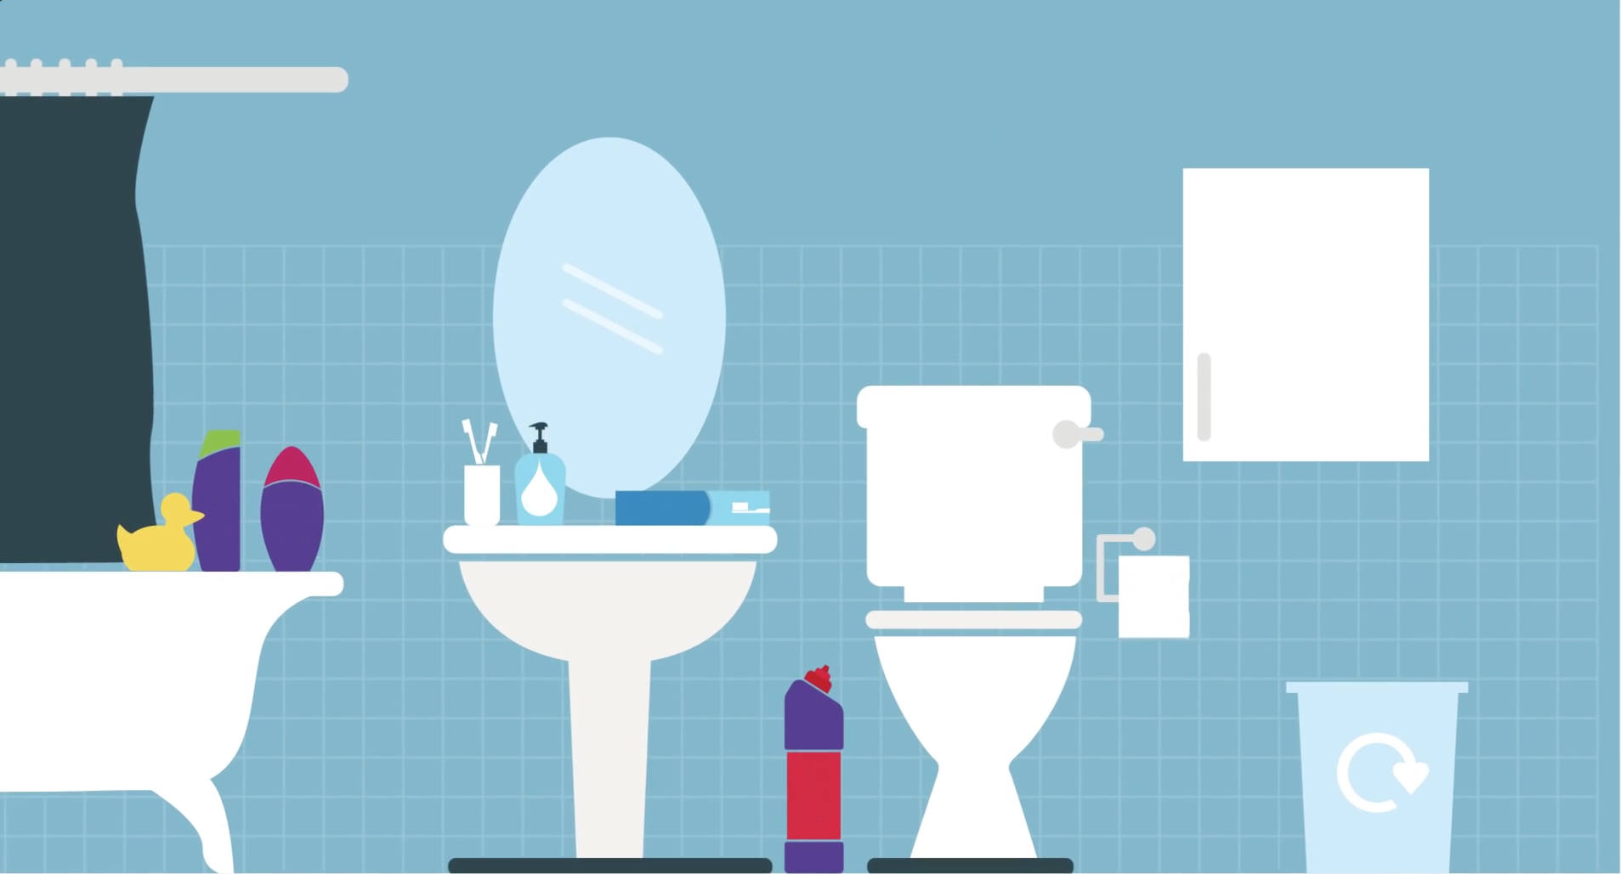
Bathroom

Slide 8
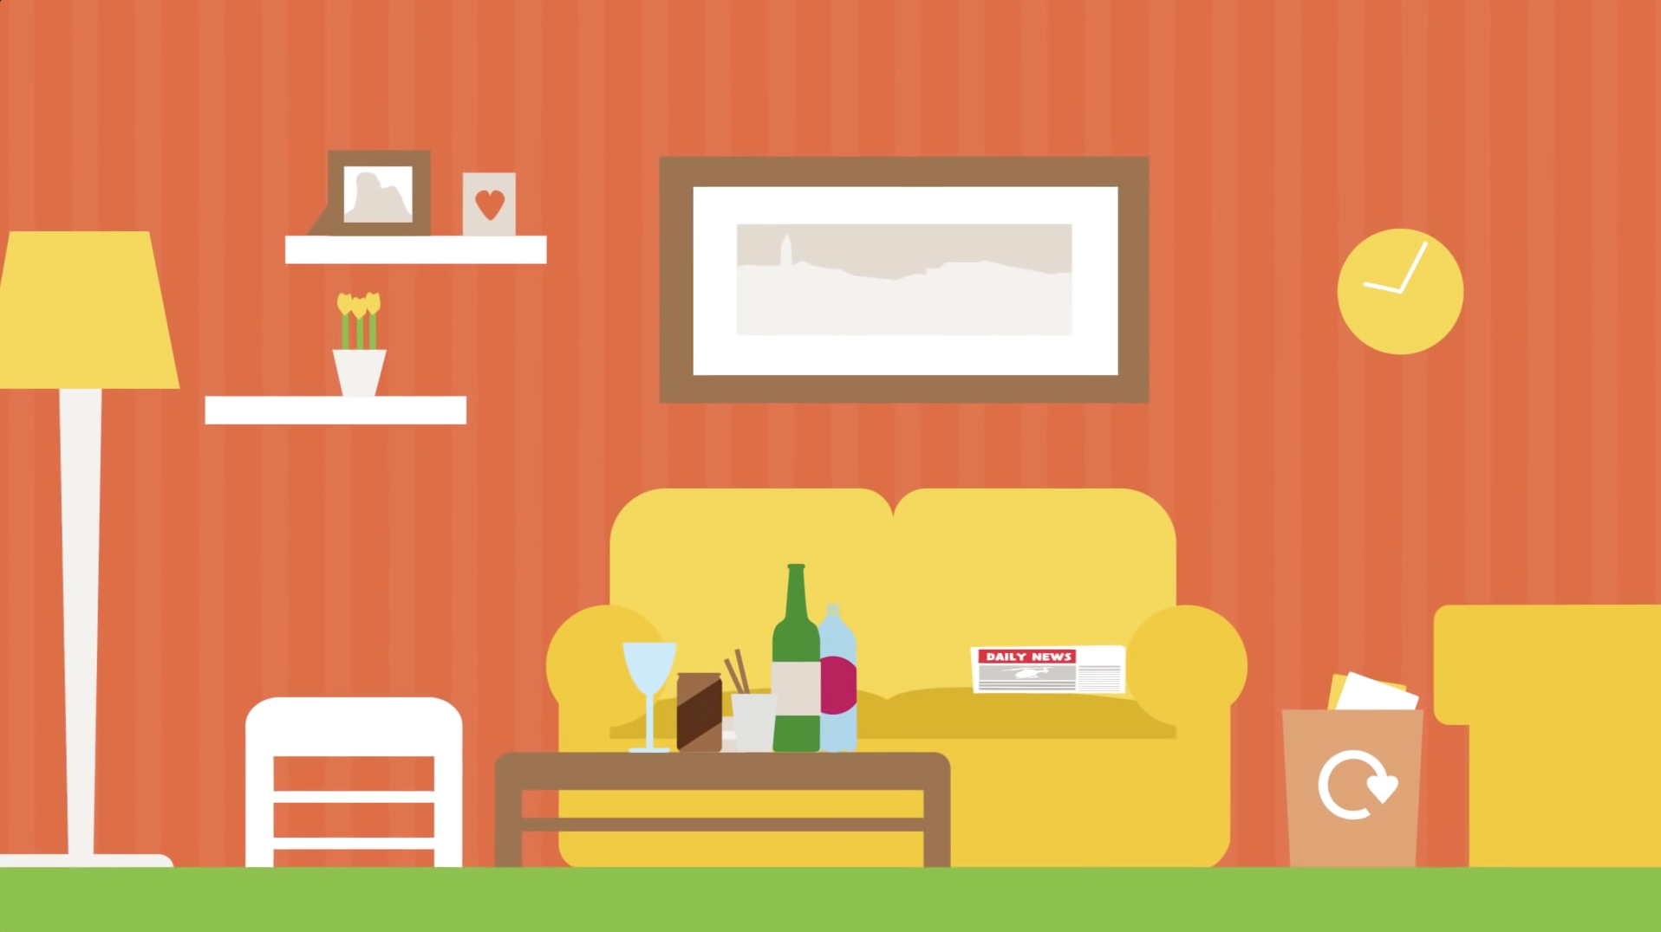
Living Room

Slide 9
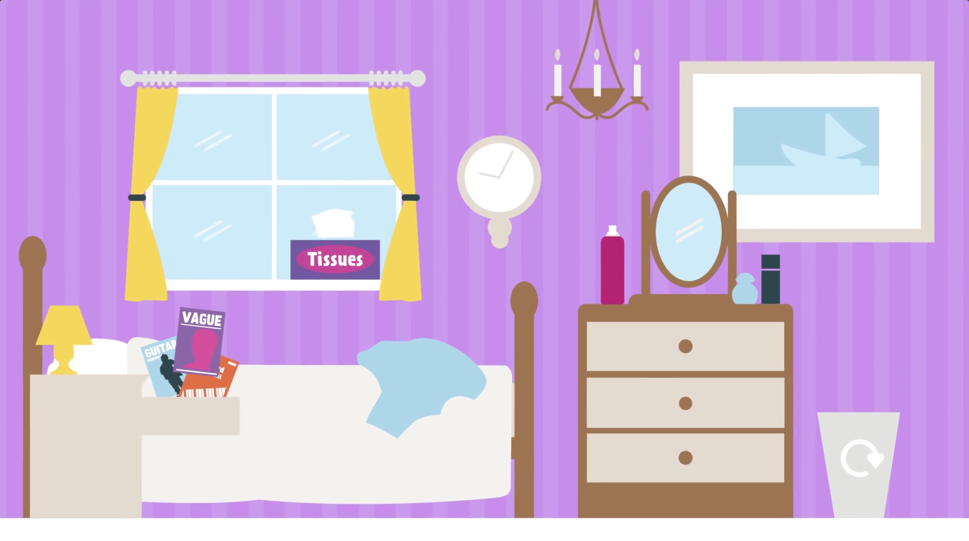
Bedroom

Slide 10
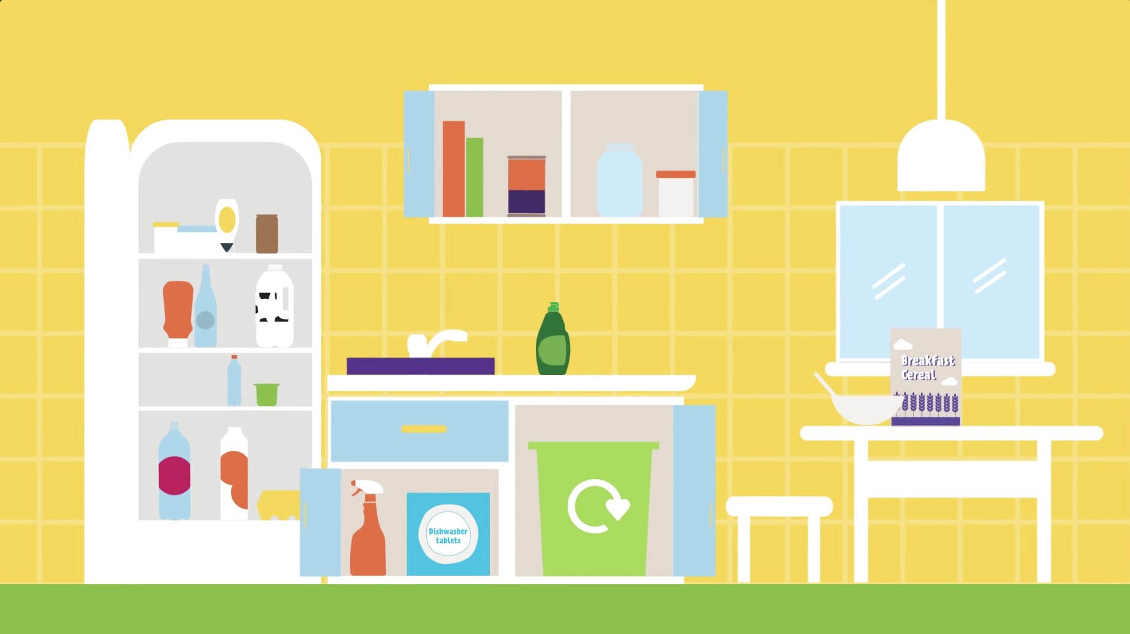
Kitchen

Slide 11

Recycling Journey
Watch the video to discover what happens to tins and cans when they are recycled.
Answer the question on the next slide!
(Click image to watch)
Video link; https://www.youtube.com/watch?v=upwQ8dV58FM&t=223s

Slide 12

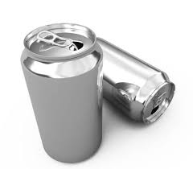
Recycling Journey
Question:
How quickly can an aluminium can be recycled
and appear back on a store shelf?
Answer:
Just 8 weeks!

Slide 13
How can I recycle?
Rinse old plastic bottles and containers
Squash items to make more space in your recycling containers
Sort the recycling into different materials
Put the items in the correct bin

Slide 14
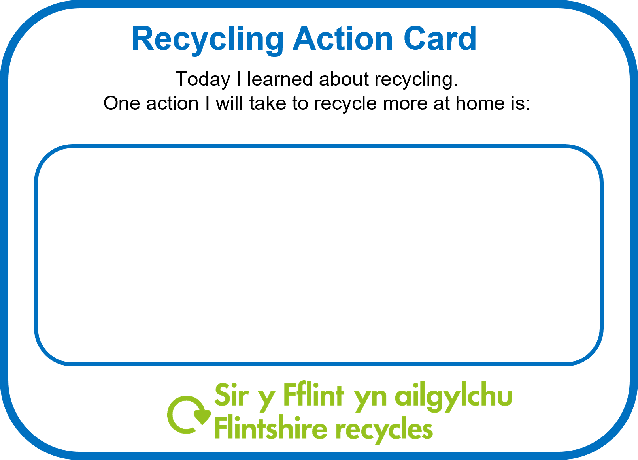

Recycling Action
What could you do to recycle more at home?
Complete an action card by writing at least one action
Take the card home to show your parent(s) / carer(s)
Next week we can see how everyone is getting on with their actions

Slide 15
Thank you!

